Slide 1
Thinking of buying a House….
Preeti Motwani Dr. Asmita Titre
Sujata Phad
Rutuja Dhanawade
ALLPPT.com _ Free PowerPoint Templates, Diagrams and Charts

Slide 2

Dream house ..

Slide 3
Ames housing project
Here, we predict house price for the test data using advanced analytical techniques with R
Also to have the lowest possible errors
Lets get started…

Slide 4
The data
Train – 81 variables
Test - 80 variables
Target Variable—Sale Price

Slide 5
Packages Used
dplyr
e1071
ggplot2
Hmisc
Caret
ranger
gbm
Xgboost

Slide 6
The Hypothesis….

Slide 7
High correlation of Variables with Saleprice
Variables | Correlation(>0.5)
OverallQual | 0.7909816
YearBuilt | 0.5228973
YearRemodAdd | 0.507101
TotalBsmtSF | 0.6135806
X1stFlrSF | 0.605822
GrLivArea | 0.7086245
FullBath | 0.5606638
TotRmsAbvGrd | 0.533732
GarageCars | 0.6404092
GarageArea | 0.6234314
SalePrice | 1
ExterQual | -0.6368837
BsmtQual | -0.6055483
KitchenQual | -0.5891888

Slide 8
Low correlation with variables
Variables | Correlation(<0.1)
MSSubclass | -0.08428414
OverallCond | -0.07785589
BsmtFinSF2 | -0.01137812
LowQualFinSF | -0.02560613
BsmtHalfBath | -0.01684415
X3SsnPorch | 0.04458367
PoolArea | 0.09240355
MiscVal | -0.02118985
MoSold | 0.04643225
YrSold | -0.02892259

Slide 9
Cont…
Variables | Correlation (<0.1)
Street | 0.04643225
Landcontour | 0.01545324
Utilities | -0.0143143
LotConfig | -0.06739602
Landslope | 0.05115225
Condition1 | 0.09115491
Condition2 | 0.007512734
BldgType | -0.08559061
MasVnrType | 0.01790688
BsmtCond | 0.05766314
BsmtFinType1 | -0.07099458
BsmtFinType2 | 0.04248653
Heating | -0.09881208
FirePlaceQu | -0.09355707
SaleType | -0.05036954

Slide 10
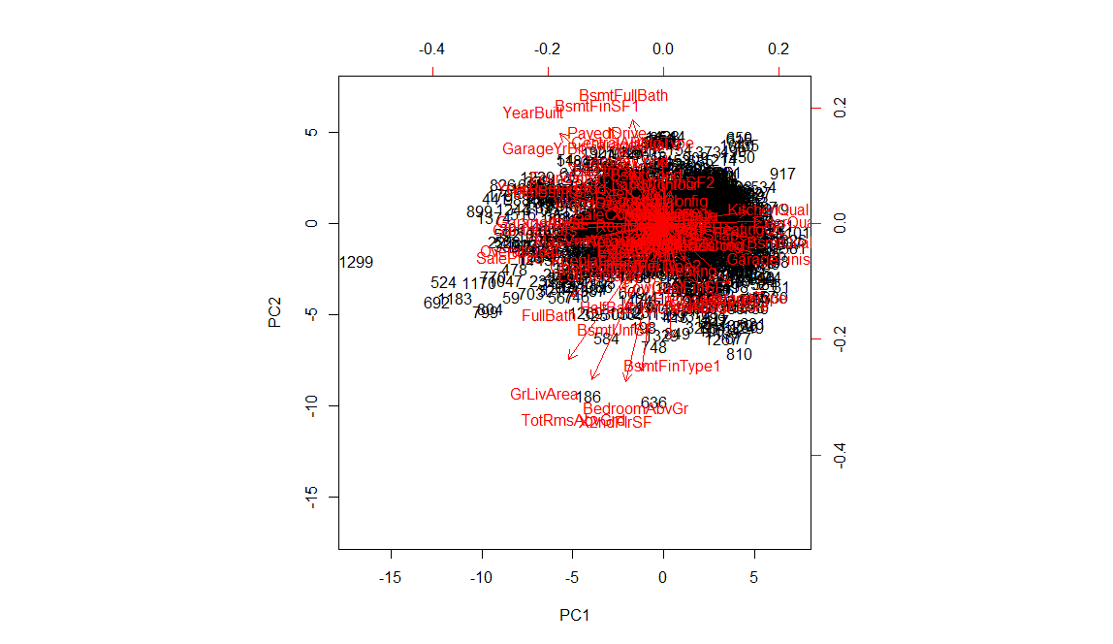
PCA

Slide 11
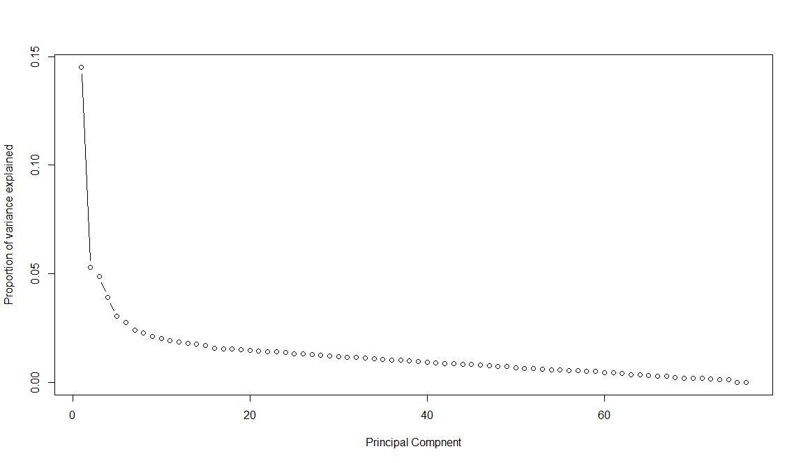
PCA is able to explain proportion of variable

Slide 12
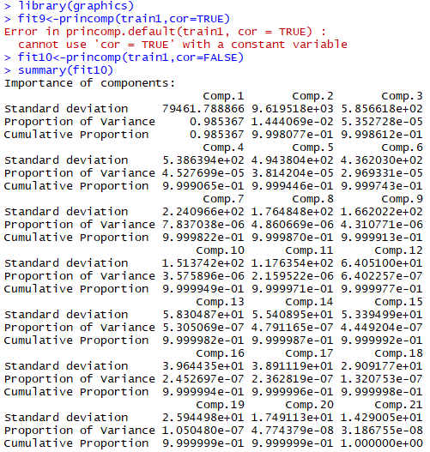

Slide 13
Exploratory
Data Analysis

Slide 14
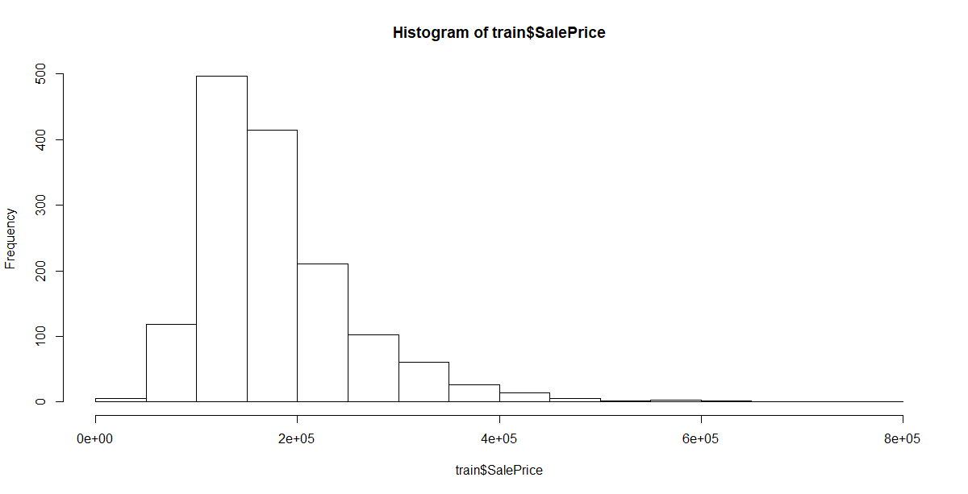
Sale Price-y variable

Slide 15
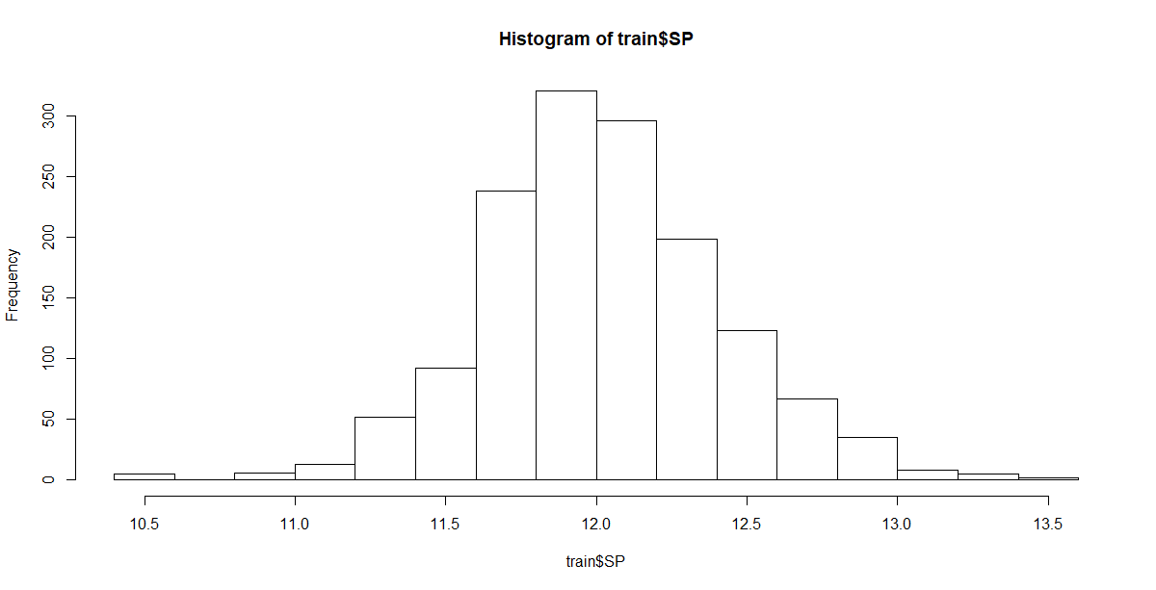
Log Transformed Target Var

Slide 16
Statistical study
Before Log Transformation
quantile(train$SalePrice)
0% 25% 50% 75% 100%
34900 129975 163000 214000 755000
After Log Transformation
quantile(train$SalePrice)
0% 25% 50% 75% 100%
10.46024 11.77510 12.00151 12.27373 13.53447

Slide 17
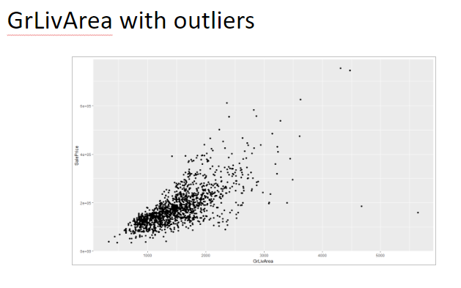
Most Contributing Variable

Slide 18
Data cleaning and
Manipulation

Slide 19
Steps followed in EDA
Removed variables having above 50% NA values
Merged Train n Test dataset
Character missing values replaced with mode values
Numeric missing values replaced with mean/ median value respectively.

Slide 20
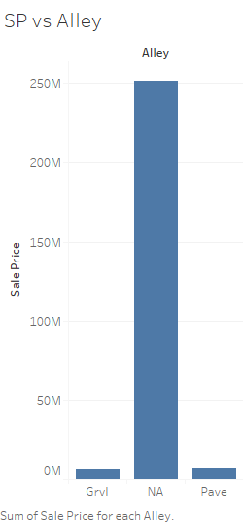
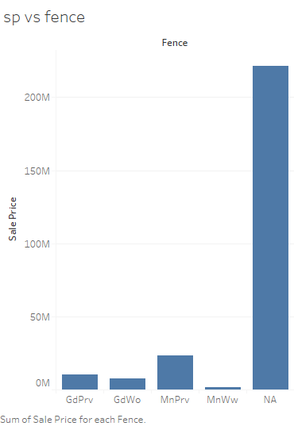
Variables like Alley, Fence

Slide 21
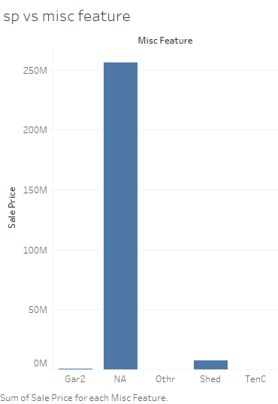
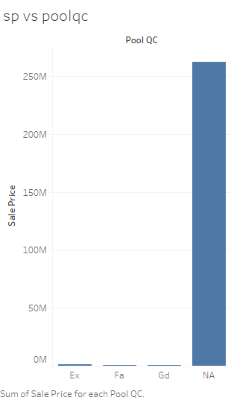
Misc features and pool qc

Slide 22
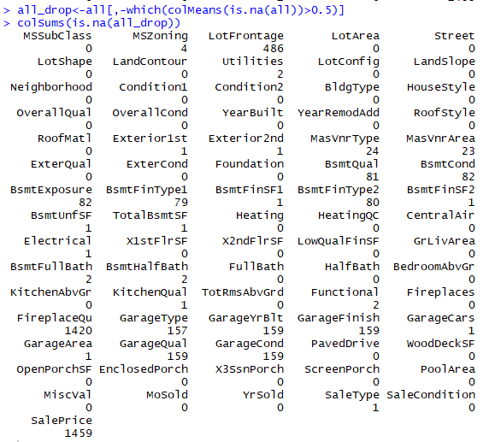
After removing variables which had more than 50% missing values

Slide 23
Hence we have our variables as :
Categorical variables as 2919_39
Numerical variables as 2919_37

Slide 24
After filling missing values in all categorical and numerical variables
Also converting our categorical variable into numerical
Further our data looks-all numeric- 2919_76

Slide 25
Model implementations –
Machine learning
Algorithms

Slide 26
Models Implemented along with Cross Validation
Random Forest
Gradient Boosting Method
X treme Gradient Boosting Method
Linear Regression

Slide 27
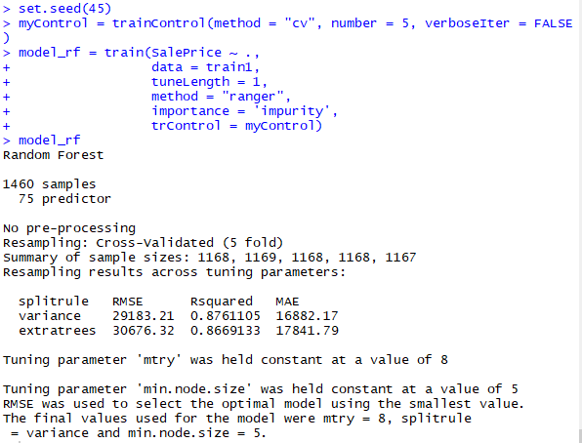
Model 1-RF1

Slide 28
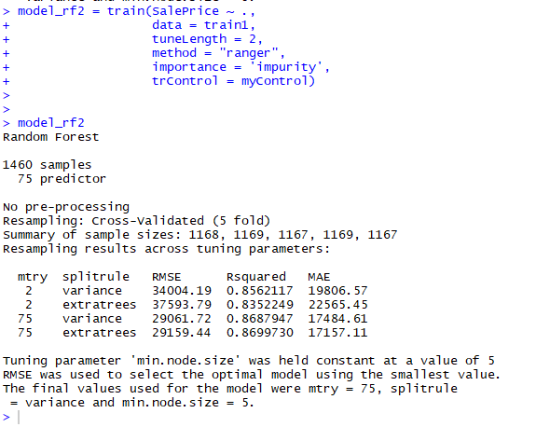
Model2-RF2 with 2 mtry values

Slide 29
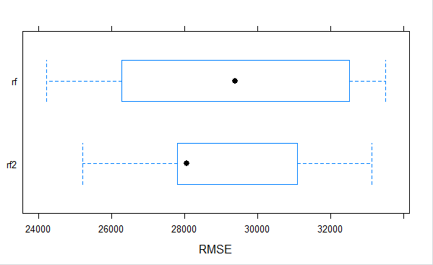
Comparing our RF1 and RF2

Slide 30
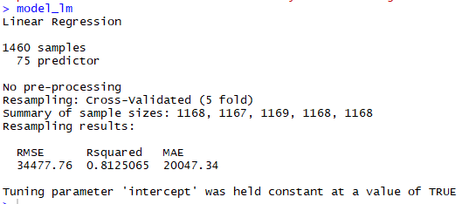
Model 3-LR

Slide 31
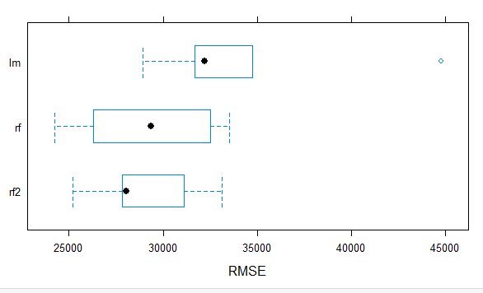
Comparing our RF1 ,RF2 and LR

Slide 32
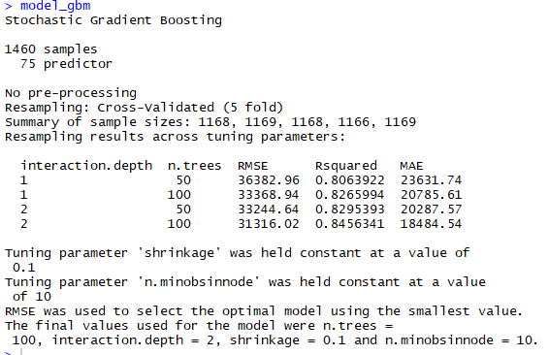
Model 4-GBM

Slide 33
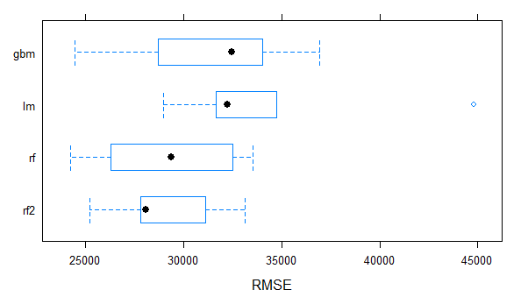
Comparing our LR,RF1,RF2 and GBM

Slide 34
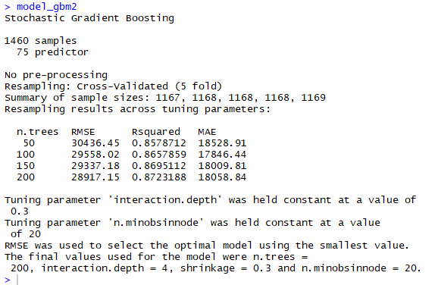
Model 5-GBM2

Slide 35
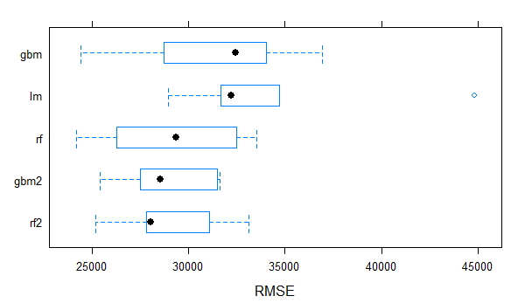
Comparing our LR ,RF1,RF2,GBM and GBM2

Slide 36
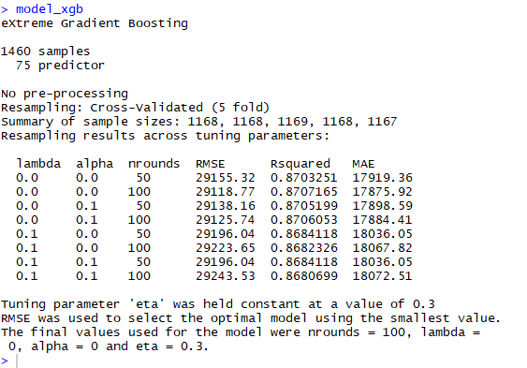
Model 6-XGBM

Slide 37
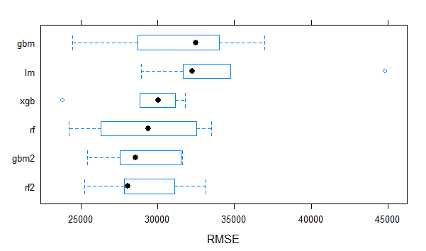
Comparing our LR ,RF1,RF2,GBM,GBM2 and XGBM

Slide 38
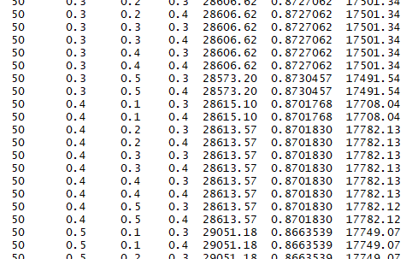
Model 7-XGBM with tuning parameters

Slide 39
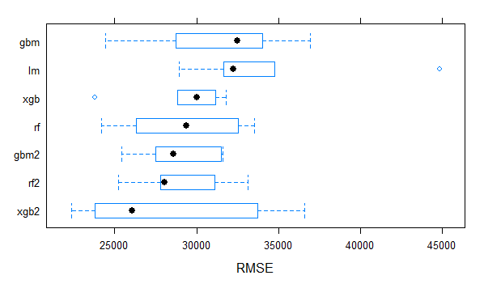
Comparing our LR ,RF,RF2,GBM,GBM2 and XGBM

Slide 40
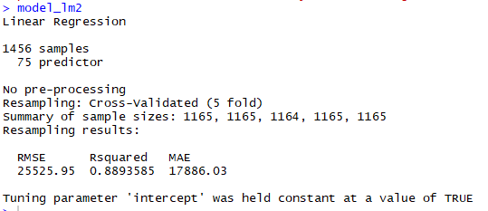
Model 8-LR with trimmed data

Slide 41
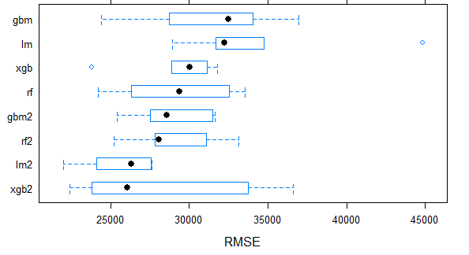
Comparing our LR ,RF1,RF2,GBM,GBM2,XGBM and LM2

Slide 42
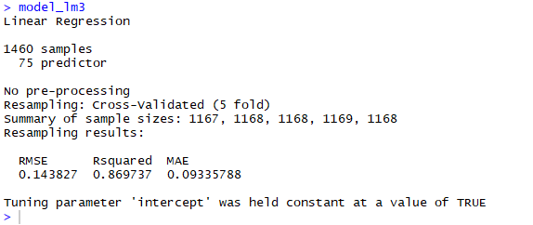
Model 9-LR with log transformed data

Slide 43
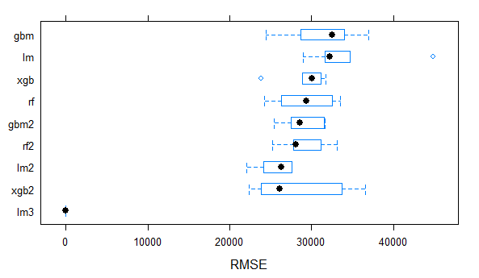
Comparing our LR ,RF1,RF2,GBM,GBM2,XGBM,LR2 and LR3

Slide 44
Final Thoughts…

Slide 45
Conclusion
How to clean and process real life dataset
Considerable amount of data pre-processing done
Understanding Assumptions and statistical theory
A simple model like LM can outperform a more advanced model like xgboost

Slide 46

Thank you !

